Slide 1
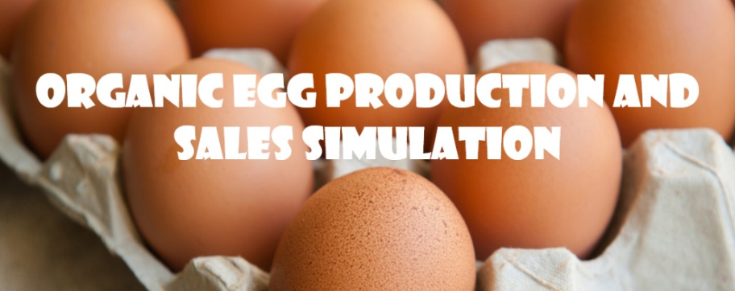

Christian Thieme
DATA608
5/19/2021

Slide 2
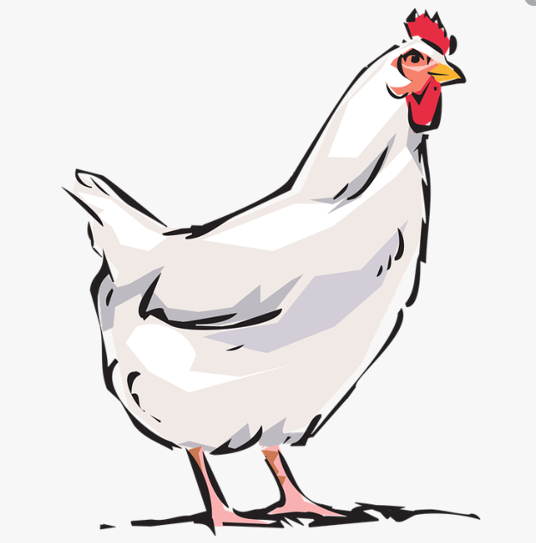
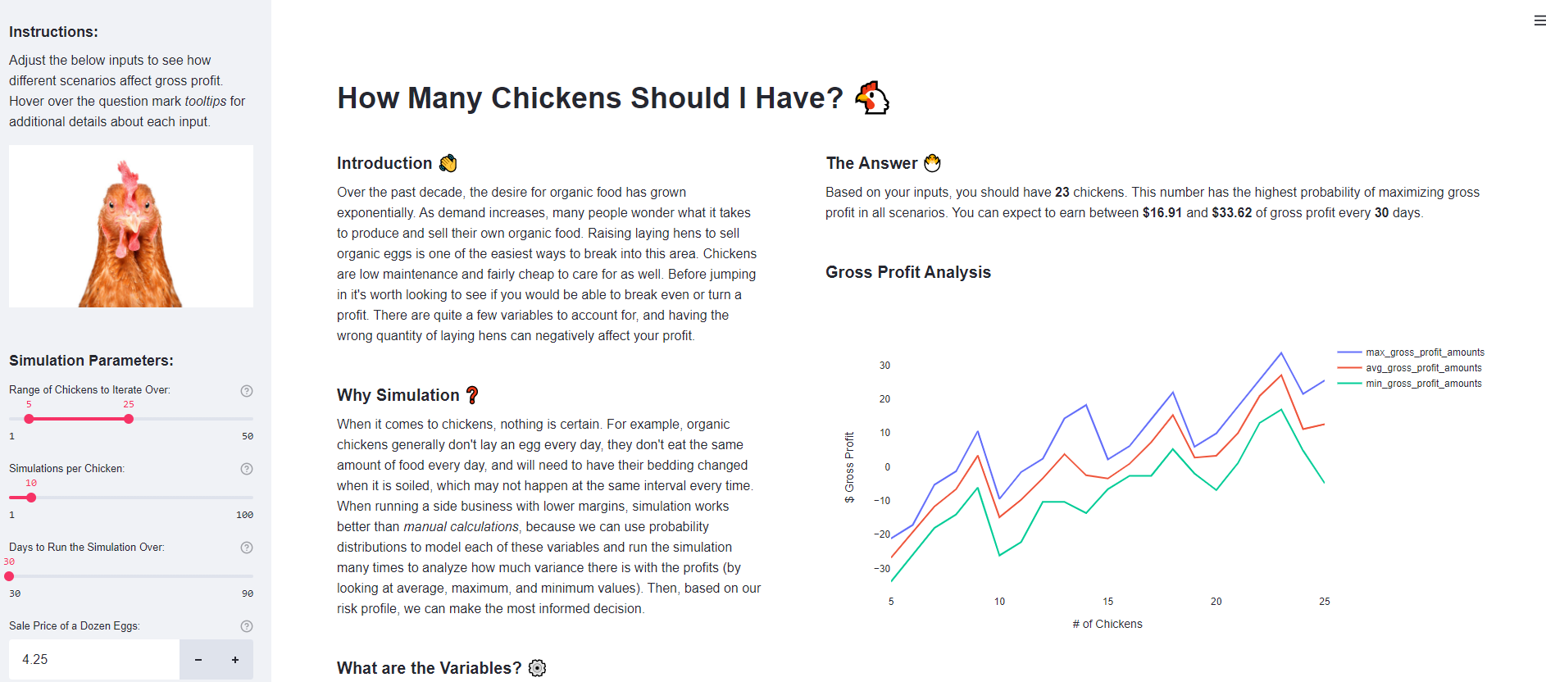
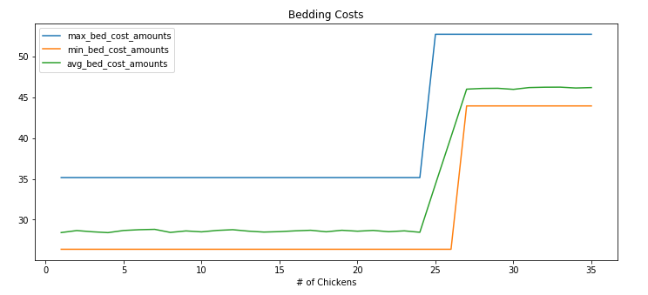
PROBLEM STATEMENT: How Many Chickens Should I Get?
While revenue from selling eggs is linear, COSTS ARE NOT
A 35 lbs bag of feed might feed 5 chickens for a month, but if you had 6 chickens you would need to buy a second bag every month, essentially doubling your costs
Costs tend to follow a stair step trend
.
At certain thresholds, costs increase – this means that more isn’t always better and that there is an optimal number of chickens within the given range you can maintain (i.e. 15-25 chickens based on living space requirements).

Slide 3
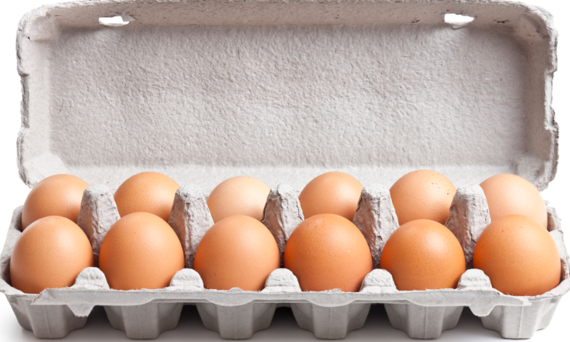
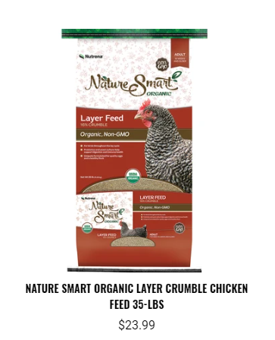
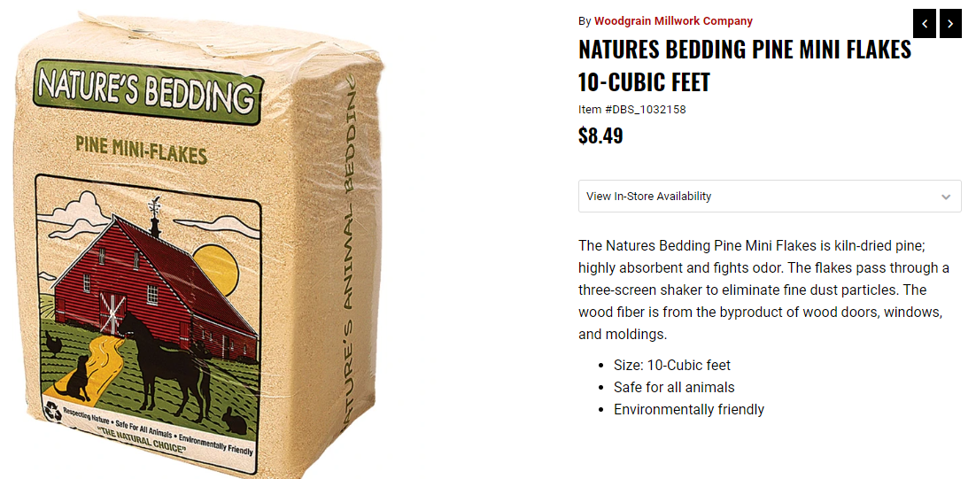
How Does it Work?
For the casual hen owner (1-50 chickens) looking to sell eggs, there are really three areas of interest that need to be accounted for:
Revenue - How much money do you make from the sale of dozens of eggs?
2. Feed Cost - The cost of feeding your chickens
3. Bedding Cost - The cost of buying and replacing bedding that periodically gets soiled
REVENUE
FEED COST
BEDDING COST
---------------------------
= GROSS PROFIT
Three separate models combined to get Gross Profit

Slide 4
Revenue
Egg Production for One Chicken for One Day
Yes
1
Done for every chicken for every day
Start
Chicken
Egg?
Based on probability distribution
No
0
Sum Outcomes
/12 for dozen
# of dozen x sale price
End

Slide 5
Feed Cost
Feed Consumption for One Chicken for One Day
Multiplied by # of Chickens and Days being simulated
Start
Chicken
Eats x lbs of Feed
Based on probability distribution
Consumed > lbs in bag?
Bag of feed: x lbs
No
Yes
Cost of Bag
lbs Consumed /lbs in bag
End
Bags needed x Cost of Bag
End

Slide 6
Bedding Cost Cost
Bag of Bedding: x cubic feet
Days Until Bedding Change
Chickens to use 10 cubic feet
Days in Simulation
# of Chickens
Based on probability distribution
Based on probability distribution
Usage for all chickens for a single period
Rate of usage per chicken
Determining multiplier for how many times the bedding needs to be changed
10 /
Chickens to use 10 cubic feet
Start
Start
Days Until Bedding Change
/ Days in Simulation
Rate x # of Chickens
Times needed to refresh during simulation
Single Period
/ cubic feet in bag
Multiply
Cost of Bedding
Cubic feet needed for 1 changing period for all chickens
End

Slide 7
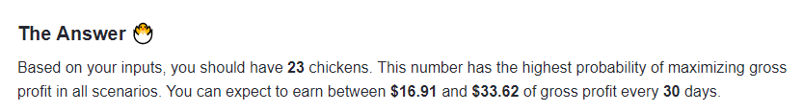
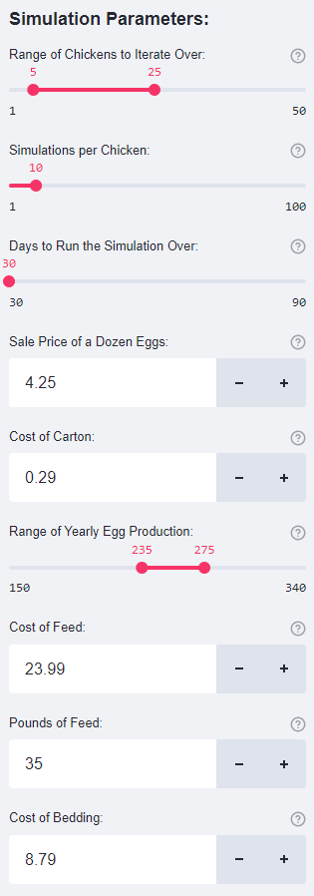
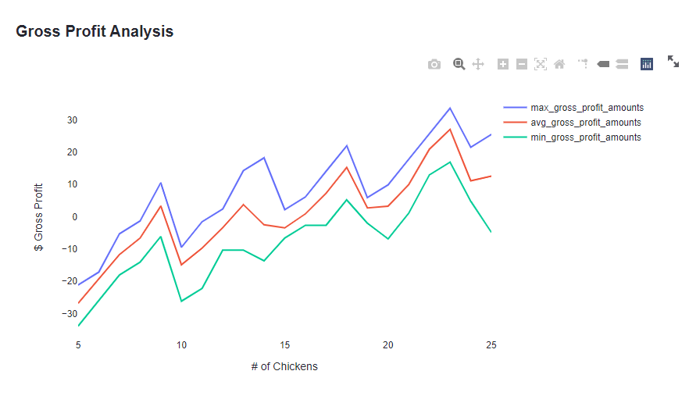
DEMO

